Slide 1

A Critique on ANSI SQL Isolation Levels
SAI SAKETH ALURU
16CS30030

Slide 2
Definitions of Common terminology
Transaction
Set of operations transforming the database from one consistent state to another.
History
Interleaved execution of a group of transactions as a linear ordering of their operations.
Conflict
Two operations, performed by distinct transactions operating on the same data item, with at least one of them doing a write action.
Data Item
Table row, space on a table, entire table, or a communication object such as a message on a queue.
History Dependency graph
Graph formed from a particular history, with operations of committed transactions as nodes, and edges <op1,op2> if operation op1 precedes and conflicts with operation op2.
Equivalent histories
Two histories are equivalent if their dependency graphs are identical.
Serializable history
A history that is equivalent to a serial history.

Slide 3
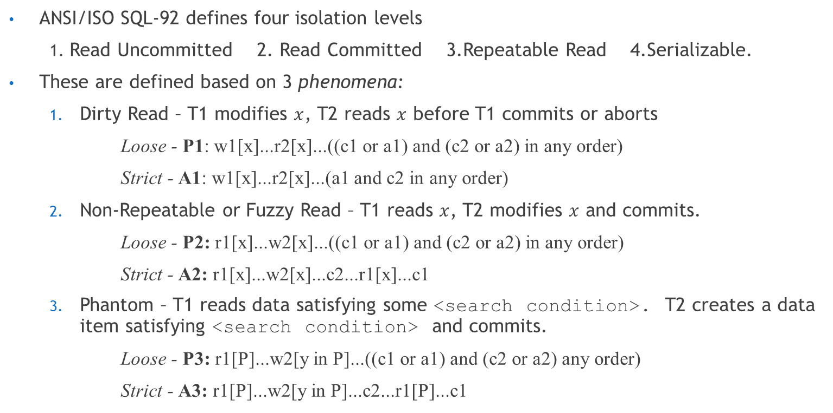
ANSI SQL Isolation Levels
ANSI/ISO SQL-92 defines four isolation levels
1. Read Uncommitted 2. Read Committed 3.Repeatable Read 4.Serializable.
These are defined based on 3 phenomena:
Dirty Read – T1 modifies $x$, T2 reads $x$ before T1 commits or aborts
Loose - P1: w1[x]...r2[x]...((c1 or a1) and (c2 or a2) in any order)
Strict - A1: w1[x]...r2[x]...(a1 and c2 in any order)
Non-Repeatable or Fuzzy Read – T1 reads $x$, T2 modifies $x$ and commits.
Loose - P2: r1[x]...w2[x]...((c1 or a1) and (c2 or a2) in any order)
Strict - A2: r1[x]...w2[x]...c2...r1[x]...c1
Phantom – T1 reads data satisfying some <search condition>. T2 creates a data item satisfying <search condition> and commits.
Loose - P3: r1[P]...w2[y in P]...((c1 or a1) and (c2 or a2) any order)
Strict - A3: r1[P]...w2[y in P]...c2...r1[P]...c1

Slide 4
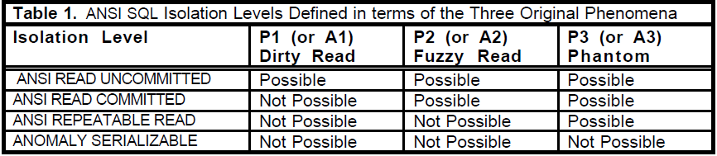
ANSI SQL Isolation Levels

Slide 5
Lock Based Isolation – some terminology
Locks
Read(Share) or Write (Exclusive) locks
Read / Write predicate lock
Lock on a set of data items satisfying a <search condition>.
Conflict
Two locks by different transactions on same item conflict if at least one of them is a write lock. Two predicate locks conflict if one of them is a write lock and there exists a (possibly phantom) data item covered by both.
Well formed operation
if an operation requests a lock before accessing the data item, or a set of data items based on a predicate.
Two phase locking
A transaction does not request any new lock after releasing some lock.
Long duration locks
Locks are held until the transaction commits or aborts.
Fundamental Serialization theorem
A well-formed, two-phase locking guarantees serializability.

Slide 6
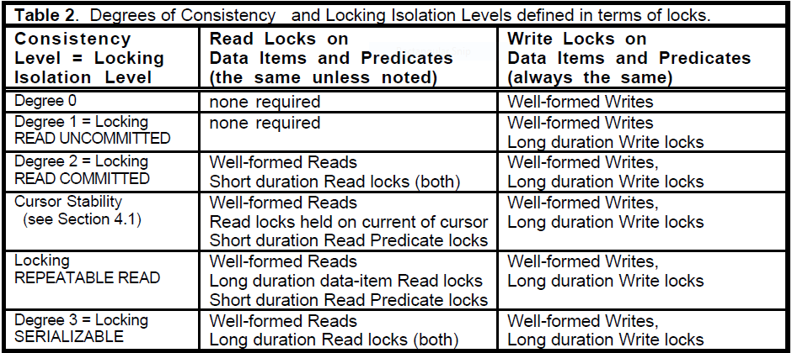
Lock Based Isolation
Locking READ UNCOMMITTED « Locking READ COMMITTED « Locking REPEATABLE READ « Locking SERIALIZABLE

Slide 7
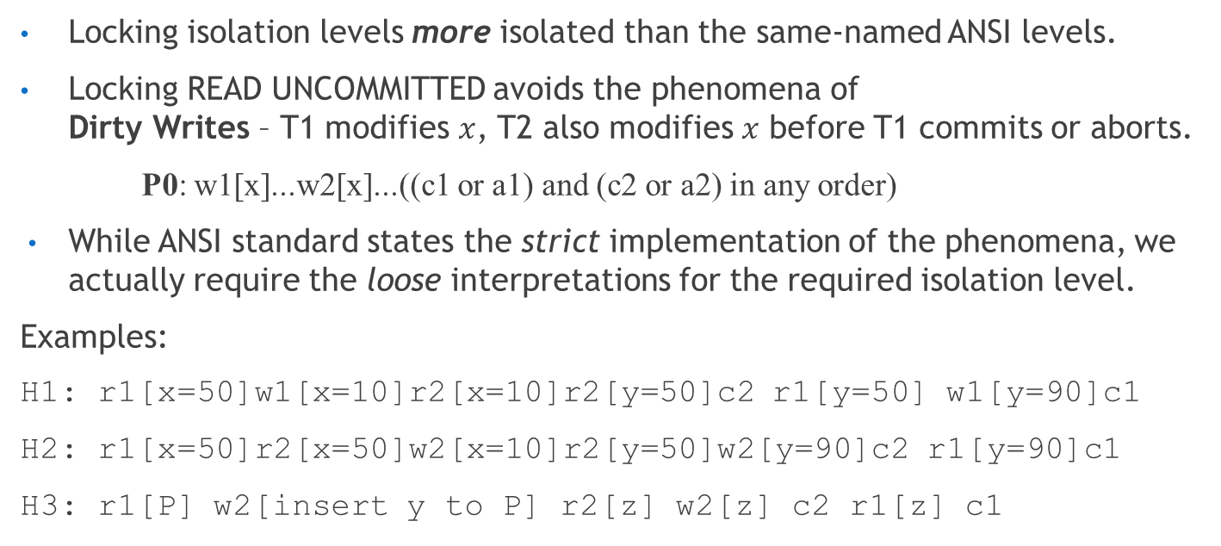
Comparing ANSI and Lock based isolation
Locking isolation levels more isolated than the same-named ANSI levels.
Locking READ UNCOMMITTED avoids the phenomena of Dirty Writes – T1 modifies $x$, T2 also modifies $x$ before T1 commits or aborts.
P0: w1[x]...w2[x]...((c1 or a1) and (c2 or a2) in any order)
While ANSI standard states the strict implementation of the phenomena, we actually require the loose interpretations for the required isolation level.
Examples:
H1: r1[x=50]w1[x=10]r2[x=10]r2[y=50]c2 r1[y=50] w1[y=90]c1
H2: r1[x=50]r2[x=50]w2[x=10]r2[y=50]w2[y=90]c2 r1[y=90]c1
H3: r1[P] w2[insert y to P] r2[z] w2[z] c2 r1[z] c1
Strict interpretations A1, A2, and A3 have unintended weaknesses. The correct interpretations are the Loose ones.

Slide 8
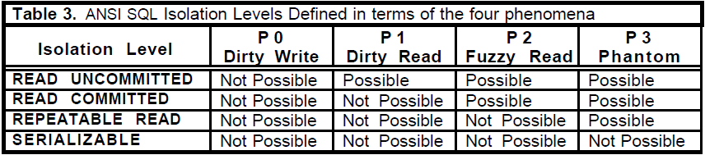
Modified ANSI Isolation levels
ANSI SQL isolation phenomena are incomplete. A better definitions are by taking the loose implementations including the dirty write phenomena.
P0: w1[x]...w2[x]...(c1 or a1) (Dirty Write) P1: w1[x]...r2[x]...(c1 or a1) (Dirty Read) P2: r1[x]...w2[x]...(c1 or a1) (Fuzzy or Non-Repeatable Read) P3: r1[P]...w2[y in P]...(c1 or a1) (Phantom)
ANSI version of P3 only talks about inserts. Here all types of writes are considered
These definitions of phenomenological isolation levels are identical to the previously defined locking isolation levels of the same name.

Slide 9
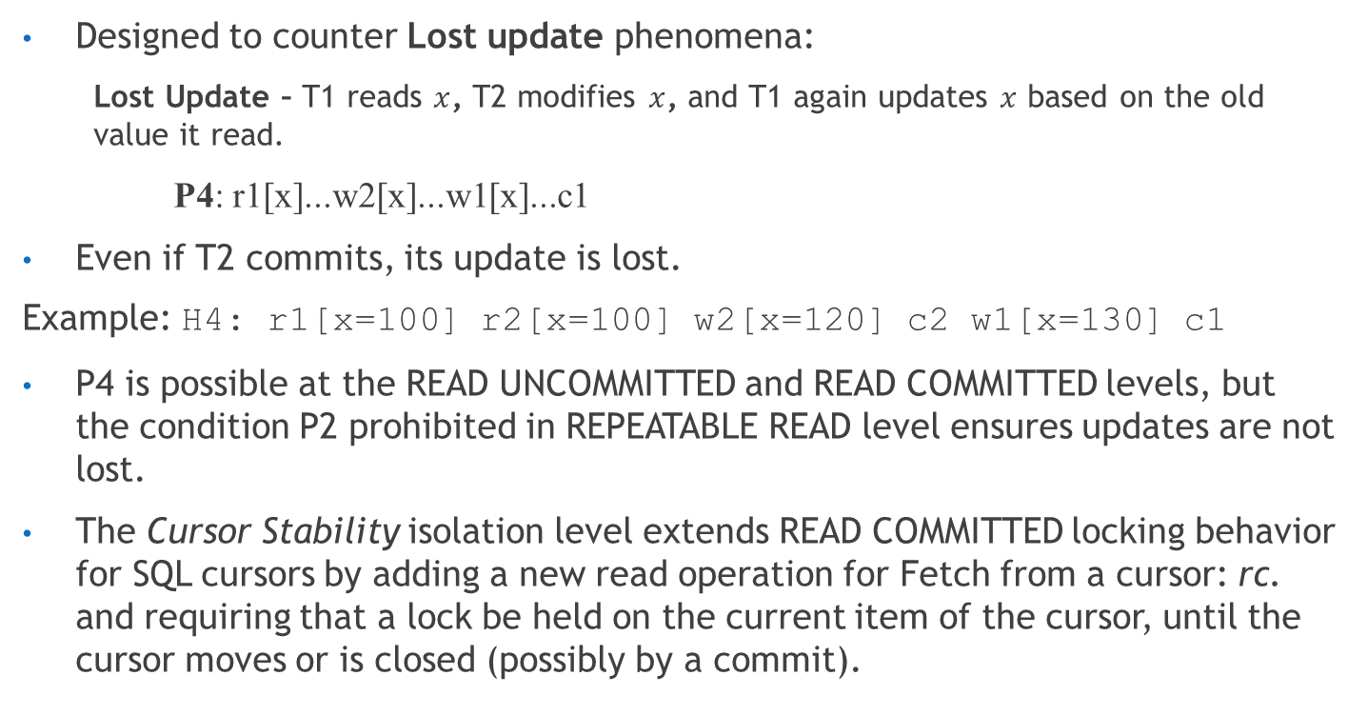
Cursor Stability Isolation level
Designed to counter Lost update phenomena:
Lost Update – T1 reads $x$, T2 modifies $x$, and T1 again updates $x$ based on the old value it read.
P4: r1[x]...w2[x]...w1[x]...c1
Even if T2 commits, its update is lost.
Example: H4: r1[x=100] r2[x=100] w2[x=120] c2 w1[x=130] c1
P4 is possible at the READ UNCOMMITTED and READ COMMITTED levels, but the condition P2 prohibited in REPEATABLE READ level ensures updates are not lost.
The Cursor Stability isolation level extends READ COMMITTED locking behavior for SQL cursors by adding a new read operation for Fetch from a cursor: rc. and requiring that a lock be held on the current item of the cursor, until the cursor moves or is closed (possibly by a commit).

Slide 10
Cursor Stability Isolation level
Thus this type of read prevents Lost Updates, by prohibiting the phenomena P4, modified as P4C.
P4C: rc1[x]...w2[x]...w1[x]...c1
READ COMMITTED « Cursor Stability « REPEATABLE READ
The programmer can parlay Cursor Stability to effective Locking REPEATABLE READ isolation for any transaction accessing a small, fixed number of data items – at the cost of using multiple cursors.
However this is not convenient, and thus there are always histories that can satisfy P4 ( or even the the more general P2) that can still contain inconsistencies.

Slide 11
Snapshot Isolation
Start-Timestamp: The time when the transaction started.
Commit-Timestamp: Timestamp issued to a transaction when it is ready to commit (transactions gets a commit-timestamp even if it ends up aborted).
A transaction always reads data from a snapshot of the data that has already been committed by its start-timestamp.
All updates made by the transaction are also reflected only in this snapshot. These updates are isolated to a particular transaction while it is active.
When a transaction T1 is ready to commit, it gets a Commit-Timestamp, which is larger than any existing Start-Timestamp or Commit-Timestamp.
The transaction T1 successfully commits only if no other transaction T2 with a Commit-Timestamp in T1’s interval [Start-Timestamp, Commit-Timestamp] wrote data that T1 also wrote.
This principle, first-committer wins, prevents lost updates (P4). After committing, its changes are now visible to all transactions with start-times greater than T1s commit time

Slide 12
Snapshot Isolation
Consider the Single version history operation
H1: r1[x=50]w1[x=10]r2[x=10]r2[y=50]c2r1[y=50] w1[y=90]c1
The snapshot isolation version of this history would be,
H1.SI: r1[x0=50] w1[x1=10] r2[x0=50] r2[y0=50] c2 r1[y0=50] w1[y1=90] c1
All Snapshot Isolation histories can be mapped to single-valued histories while preserving dataflow dependencies – The MV histories are said to be View Equivalent with the SV histories.
H1.SI.SV: r1[x=50] r1[y=50] r2[x=50] r2[y=50] c2 w1[x=10] w1[y=90] c1
READ COMMITTED « Snapshot Isolation »« REPEATABLE READ
Snapshot Isolation is non-serializable because a transaction’s Reads come at one instant and the Writes at another.

Slide 13
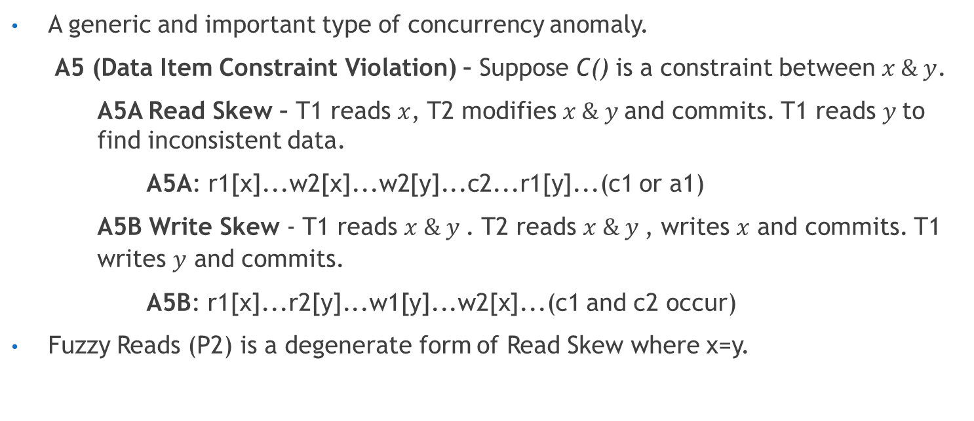
Constraint Violation
A generic and important type of concurrency anomaly.
A5 (Data Item Constraint Violation) – Suppose C() is a constraint between $x \& y$.
A5A Read Skew – T1 reads $x$, T2 modifies $x \& y$and commits. T1 reads $y$to find inconsistent data.
A5A: r1[x]...w2[x]...w2[y]...c2...r1[y]...(c1 or a1)
A5B Write Skew - T1 reads $x \& y$. T2 reads $x \& y$, writes $x$ and commits. T1 writes $y$ and commits.
A5B: r1[x]...r2[y]...w1[y]...w2[x]...(c1 and c2 occur)
Fuzzy Reads (P2) is a degenerate form of Read Skew where x=y.

Slide 14
Other Multi-version Systems
Some models of Snapshot Isolation restrict SI only to READONLY Transactions.
Oracle Read Consistency isolation:
It gives each SQL statement the most recent committed database value at the time the statement began.
It is as if the start-timestamp of the transaction is advanced at each SQL statement.
Row inserts, updates, and deletes are covered by Write locks to give a first-writer-wins rather than a first-committer-wins policy.

Slide 15
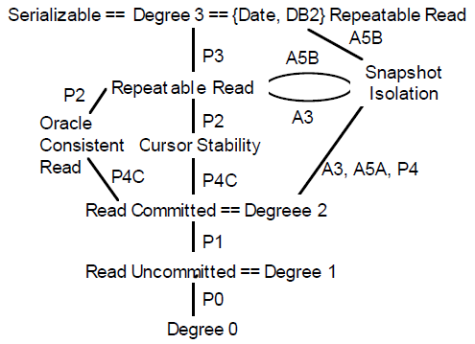
Summary and Conclusion

Slide 16
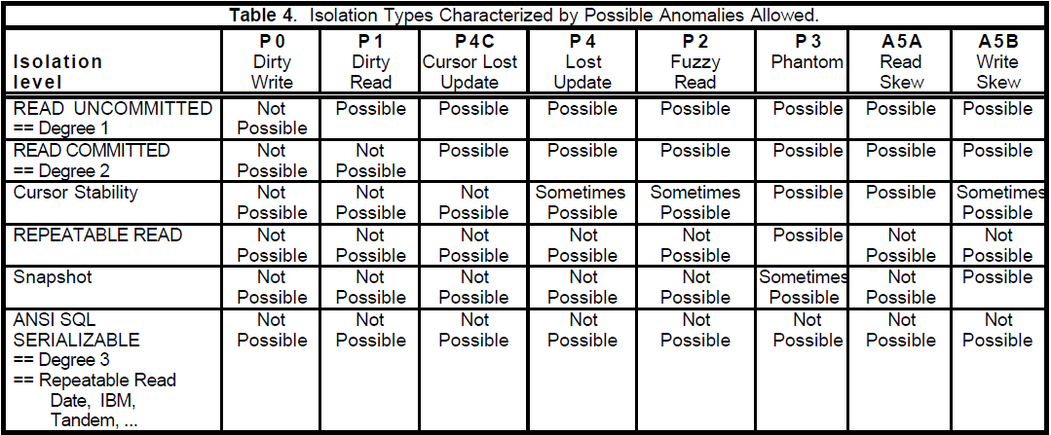
Summary and Conclusion

